Slide 1
Applied Data Science
Project Deign Phase – part 1
Group 4

Slide 2
Proposed Solutions :
Your proposed solution should relate the current situation to a desired result and describe the benefits that will accrue when the desired result is achieved.
So, begin your proposed solution by briefly describing this desired result.
Examples of proposed solution.
The proposed solution is to maintain the robot's position inside, but close, to the boundary of the target's field of view.
My proposed solution is to refuse these oppositions altogether.

Slide 3
Instructions :
With your teammates, write a two paragraph document: The first paragraph should be a problem statement for your Capstone project. This should be brief — a 100-word paragraph is typical. The second paragraph should be a proposed solution for your Capstone project. This should be brief — again a 100-word paragraph is typical. In your document, strive for clarity and conciseness. Imagine that you are trying to convince a venture capitalist that they should fund this project.

Slide 4
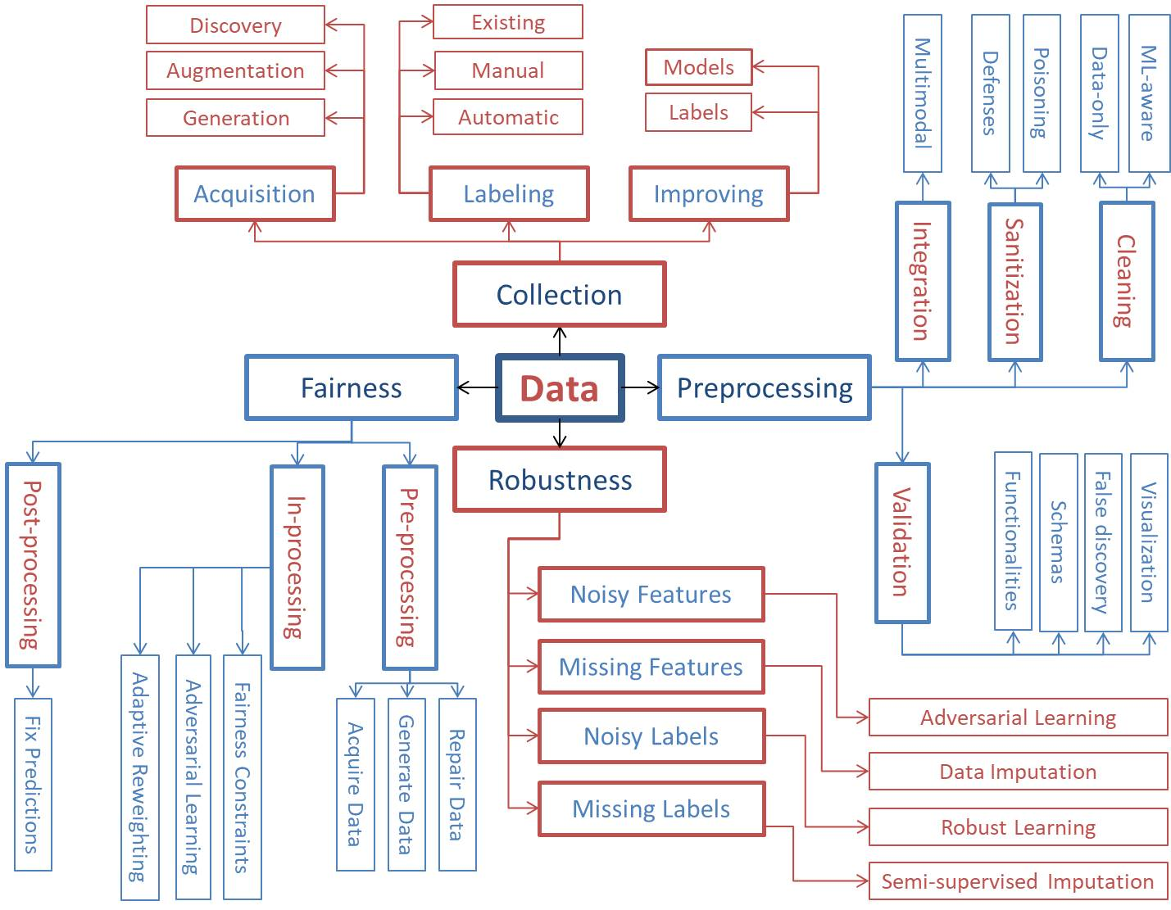

Slide 5
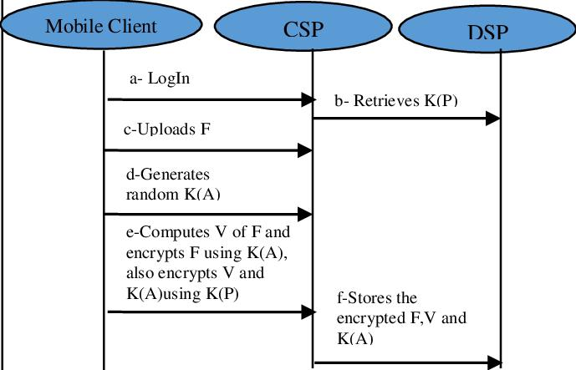
The architecture of the proposed framework:

Slide 6
The Proposed Solution of Strategy:
A proposal strategy is a plan to write a persuasive, winning proposal that sets you apart from your competitors.
Proposal strategy must align with the capture strategy in order to create win themes that tell the story.
Strategy might be the most misused word in business.

Slide 7
Example sentences propose a solution:
The solution proposed was simply to destroy the entire building. ... We quickly become patronising in our attitude to them and domineering in the solutions we propose.

Slide 8
Solution Architecture:
A solution architecture (SA) is an architectural description of a specific solution.
SAs combine guidance from different enterprise architecture viewpoints (business, information and technical), as well as from the enterprise solution architecture (ESA).
Some examples of solutions architecture include developing cloud infrastructure for efficiency, implementing microservices for ecommerce, or adopting security measures for data, systems, and networks.

Slide 9
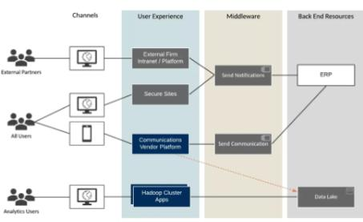

Slide 10
The solution architecture diagram should always include:
Necessary information about the managed network and application environment A logical representation of the VMware Smart Assurance components that will be installed Locations for each component including the name and IP address of the host and the geographical location of the host Connections between components and the ports that are used for communications Connections, including port numbers, between VMware Smart Assurance components and external sources such as networks and third-party software products This diagram cannot be completed until the design is complete and deployed, so recommendations for adding information to the diagram appear throughout this guide.

Slide 11
How to draw an architectural diagram:
Document your shapes. ... Label the edges. ... Keep your arrows consistent. ... Use colors sparingly. ... Use multiple diagrams, if necessary. ... Merge incomplete diagrams. ... Include legends/keys/glossaries. ... Use diagramming software.

Slide 12
Types of Solution Architecture Diagrams:
The Flow Diagram. The most generic and generally broadest reaching diagram you can make is the flow diagram. ... The Service Diagram. A service diagram illustrates connectivity from a high level. ... The Persona Diagram. ... The Infrastructure Diagram. ... The Developer Diagram.

Slide 13
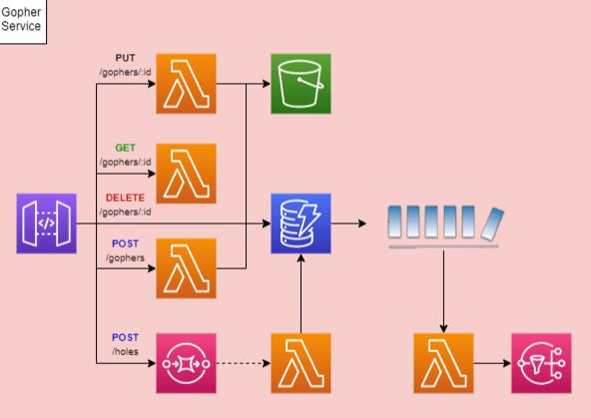

Slide 14
Purpose Of Solutions Architecture :
The solution architecture helps ensure that a new system will fit the existing enterprise environment.
To perform this task, a solution architect has to understand how all parts of the business model work together including processes, operating systems, and application architectures.

Slide 15
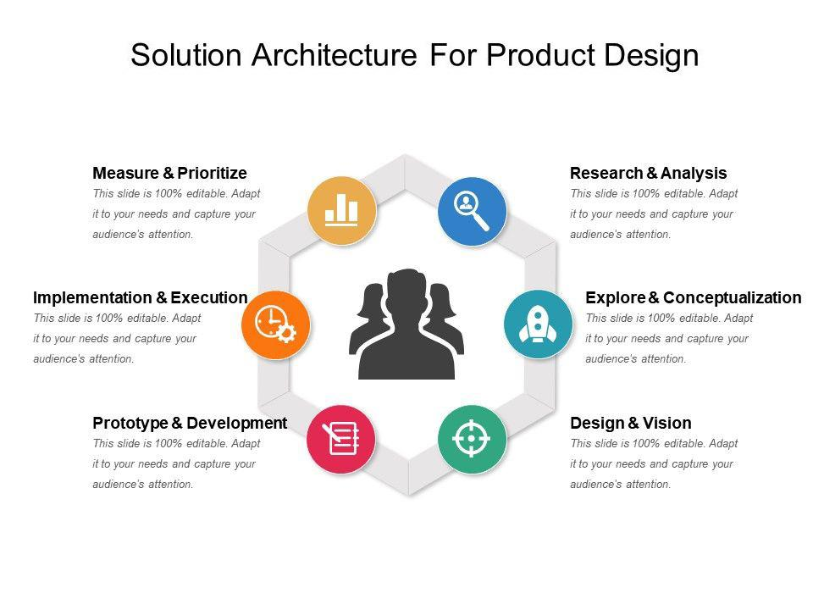

Slide 16
